Slide 1
Progress Report
Sports Analysis – Prediction of Player Market Value
Pranav Vispute
19247207

Slide 2
Introduction
Sports Analytics has emerged as an important field in modern sports. Using Data Science, Machine Learning to enhance performance, strategy and decision Making.
Usually Market Value of a player is an estimate of the money a club would be willing to spend to secure a player, even if no actual transfer takes place (Sun, Y. and Gu, K., 2024).
Players valuation is heavily relied on expertise and judgment of scouts and managers. These decisions suffer inconsistency and lags in response to real—time developments.
Recent advancements demonstrate that data-driven models that leverage machine learning can provide better results than crowd predictions in terms of both accuracy and transparency.

Slide 3
Aim
Explore ML models and evaluate its performance using metrics like MAE, MSE, R2 and RMSE.
Provide insights that can support football clubs in making data driven decisions.
Objective
Use publicly available data of Football Players match Statistics and their Market Value.
Identify Key factors that influence Players Market Value.
Build and Train ML models; evaluate to determine which performs the best.

Slide 4
Literature Review ML And player evaluation
(Sun, Y. and Gu, K., 2024.) – This research develops regression model by using video game data and actual football league data to predict player market value in major European leagues. This study identifies important player attributes and validates the accuracy of different prediction models.
(Müller, O., Simons, A., & Weinmann, M. (2017)) – This study demonstrates a multilevel regression using real football data, providing more objective and consistent prediction approach than traditional expert opinions and crowd estimations.
(Al-Asadi, M. A., & Tasdemir, S. (2022).) – This study also used Fifa Game and real data, applying four regression models i.e. Linear, Multiple Linear, Decision Tree and Random Forest. It demonstrates that ML can surpass expert evaluations in reliability and accuracy.

Slide 5
Literature Review Evaluation Metrics
(Nau, R., 2015.) – This is an explanation for how the R2 statistics represents the percentage of variance in the dependent variable explained by model features.
(Chai, Tianfeng & Draxler, R.R.. (2014)) – This research is an explanation and an argument stating RMSE and MAE are useful, especially when errors follow a normal distribution.

Slide 6
Progress Report
Data Used:
2025-2026 Big 5 European Leagues Stats (players) | FBref.com (English Premier League)
https://www.transfermarkt.com/schnellsuche/ergebnis/schnellsuche?query={player_name}
Fbref provides a detailed statistics for football players including football metrics like Goals, Assists, Expected Goals, expected Assists, pass completion, etc.
Transfermarket provides data that includes estimated player value, Match results, club information, position played, contract details, etc.
Combining these two data, this project gets necessary input features and target variable to build and evaluate models.

Slide 7
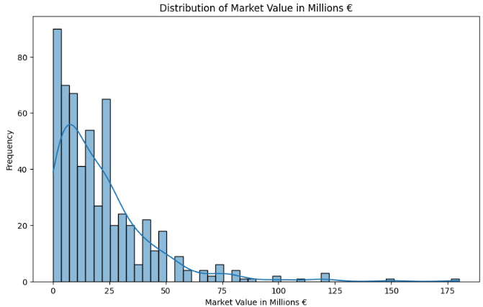
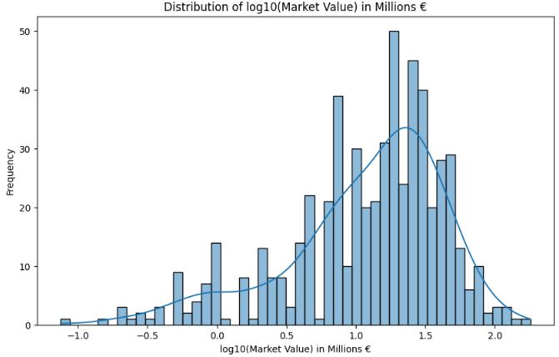
Data Preparation:
Used Pandas and BeautifulSoup library to help scrape data from the mentioned sources.
Handling missing values.
Created new features to help model capture more complex relationships in data.
Used Log Transform for Target Variable (Market Value)

Slide 8
Model Training:
Using the Log10 of Market Value, Trained the data on Linear Regression, Ridge Regression, Lasso Regression, Random Forest and Gradient boosting regression models.
Also worked on multilevel modelling to compare it’s performance with other models.
Used Squad grouping in the multilevel modelling for heirarchy.

Slide 9
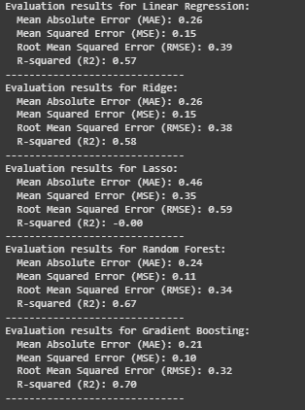
Model Evaluation:
In comparison Gradient boosting performed very well.
It shows low error (RMSE) and better prediction accuracy (R-squared)

Slide 10
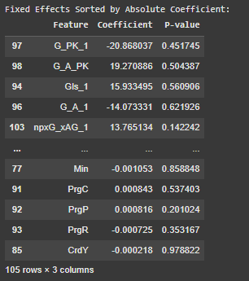
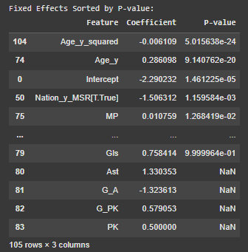
Multilevel modelling

Slide 11
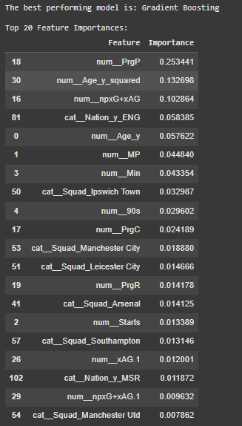
Feature importance
Based on the results Gradient Boosting performs better and the important features that contribute to prediction of target variable (Market Value) are:
PrgP: Progressive Passes
Age_Squared: Capturing non-linear relationship between age and market value.
npxG+xAG: Expected Goals and Assisted Goals
Club Nationality

Slide 12
Issues Encountered
Data Accuracy and Completeness:
Inconsistencies during Scrapping process may impact model’s performance. During data Scrapping from TransferMarket using Player Names in Fbref data, some of the player data was not scrapped due to showing a message “No Player Found.”
The Market Value data is skewed and has outliers, as seen in histogram of the data.

Slide 13
Addressing risks
Some of the missing data points are handled, helping avoiding errors and ensuring the models can be trained on a more complete dataset.
Applying Log transformation to Market Value helps with the Skewness and improve model performance.
Data Management
https://drive.google.com/drive/folders/1gB9hyT47RLJ5hVheaHOngIuTcVtWg8h9?usp=drive_link
https://github.com/Pranav216/Dissertation_19247207.git

Slide 14
Legal Issues
Social Issues
Must review website policies to Scrape data and not violate website’s terms of service.
Data based on nationality, race or gender could lead to unfair player valuations.
Publicly available data should not put pressure on player or impact their mental health.
Ethical Issues
Environmental Issues
Professional Issues
Implementation results should be fair to all Players, regardless of their background or club they play for.
Training large data on complex ML models can consume energy, contributing to carbon emissions.
Market Values predictions are quite uncertain. It is important to communicate this uncertainty with the stakeholders.

Slide 15
Conclusion
This Project is set out to develop a data-driven approach for estimating the market value of football players using their publicly available data.
Analyzing data by correlations between features and Market Value, this provides initial insights into factors influencing market value and the nature of data.
With evaluation of regression models Random Forest and Gradient Boosting had performed the best in predicting market value compared to other linear models. It is possibly because their ability to capture non-linear relationships and interactions.
An attempt to implementing multilevel model suggested that there is significant Difference in player market value that is related to the club they play for, accounting for this hierarchical structure.
Overall the performance of Tree based models was better than linear model and multilevel model in terms of getting accuracy for prediction and getting important features that contribute to the players market value.

Slide 16
References
Sun, Y. and Gu, K., 2024. Prediction of Football Players’ Value in the Transfer Market of Well-known European Leagues based on FIFA 19 and Real-world Data. INTERNATIONAL ARAB JOURNAL OF INFORMATION TECHNOLOGY, 21(4), pp.723-740. Prediction of Football Players' Value in the Transfer Market of Well-known European Leagues based on FIFA 19 and Real-world Data*
Bhilawa, L. and Fahriansyah, R., 2022. The influence of performance, age, and nationality on the market value of football players. Assets: Jurnal Akuntansi dan Pendidikan, 11(1), pp.1-9. JURNAL AKUNTANSI DAN PENDIDIKAN VOL 6 NO 1 APRIL 2017 HLMn. 1-20
Müller, O., Simons, A., & Weinmann, M. (2017). Beyond crowd judgments: Data-driven estimation of market value in association football. European Journal of Operational Research, 263(2). https://doi.org/10.1016/j.ejor.2017.05.005
Al-Asadi, M. A., & Tasdemir, S. (2022). Predict the Value of Football Players Using FIFA Video Game Data and Machine Learning Techniques. IEEE Access, 10. https://doi.org/10.1109/ACCESS.2022.3154767

Slide 17
Nau, R., 2015. What’s a good value for R-squared. Duke University, 12. What's a good value for R-squared?
Chai, Tianfeng & Draxler, R.R.. (2014). Root mean square error (RMSE) or mean absolute error (MAE)?– Arguments against avoiding RMSE in the literature. Geoscientific Model Development. 7. 1247-1250. 10.5194/gmd-7-1247-2014. (PDF) Root mean square error (RMSE) or mean absolute error (MAE)?– Arguments against avoiding RMSE in the literature

Slide 18
Thank you

